Slide 1
VIRTUAL REALITY - PRACTICAL APPLICATIONS

Slide 2
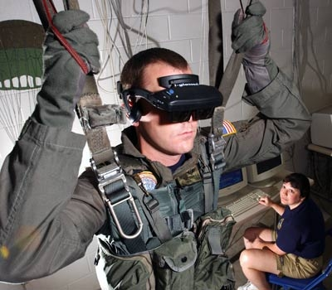
Virtual Reality (VR) is perhaps the most cutting-edge and futuristic of all the digital arts we will discuss in this class. Just the thought of VR has captured the imaginations of scientists as well as leaders in the military, the game world, medical doctors, and scientists.

Slide 3
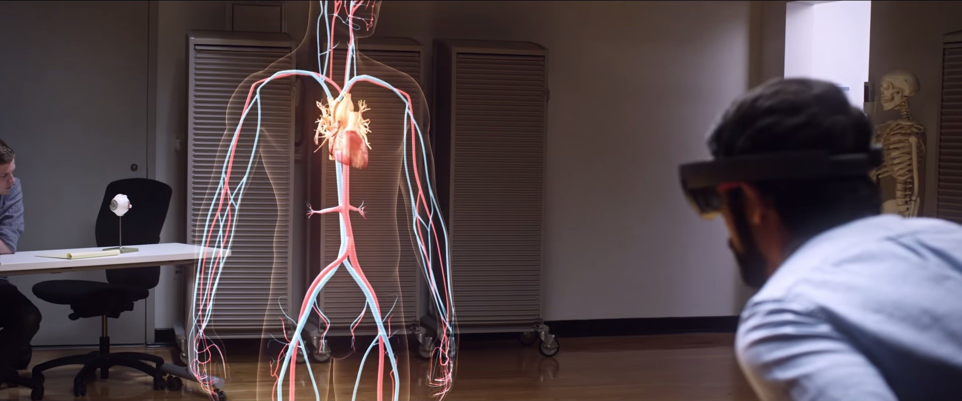
VR IN THE FIELD OF MEDICINE
In the past, some science fiction movies have depicted the use of virtual reality in futuristic medicine. Even though these movies were science fiction in their time, today the use of VR in medicine is actually happening. Let's see how VR technology is being used to heal people today.

Slide 4
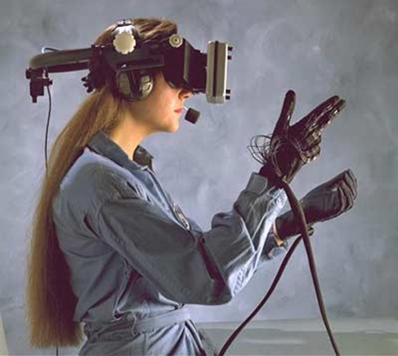
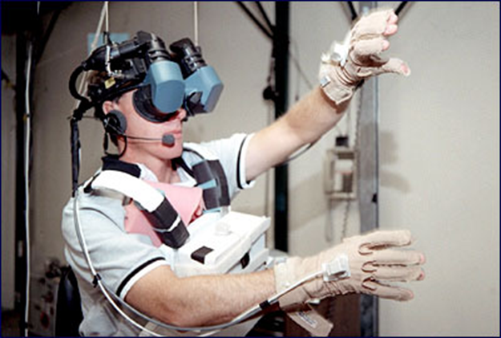
These images often come to mind when we think of VR. We'll see in this lesson that there is much more to virtual reality than odd headgear and gloves.

Slide 5
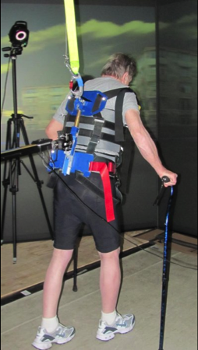
VR for Physical Therapy
This machine, called the Vr Tread, helps people re-learn how to walk and enjoy the "outside" inside. No one wants to remain in a hospital, but here a patient remains hopeful that he can recover. In a more enjoyable atmosphere, the patient is more relaxed and focused on his therapy.

Slide 6
VR for Mind Therapy
Avatars, like you saw in the previous lesson on MMO gaming, can also be used to create new bodies for those who have disabilities with their own bodies. New technology in Brain Computer Interface software is allowing quadriplegics to control their online avatar using only their thoughts.
The technology is still new, and far from perfected, but it gives hope to people who have trouble communicating or moving. Just as humans must crawl before they walk, this technology will also go through basic stages before performing movements that are more complex.

Slide 7
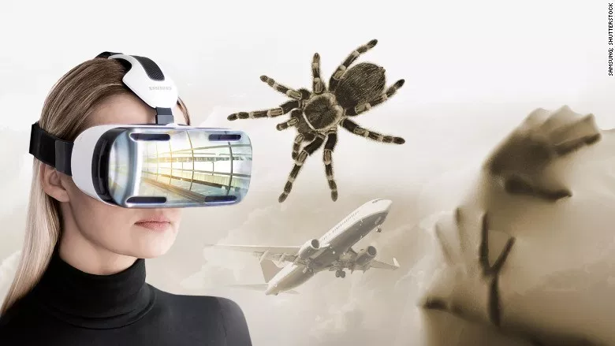
VR for Fear
Exposure Therapy
For people who have social anxiety, something as simple as riding the subway can be a terrifying experience. Virtual reality is being used to give them the chance to experience their fears in a controlled environment.
With VR, people can address their fears in a safe environment, with a therapist guiding them through the experience. Exposure therapy works for phobias such as aviophobia (fear of flying), claustrophobia, (fear of confined spaces), and amaxaphobia (fear of riding in a car).

Slide 8
Military and VR
Soldiers coming home from Iraq are finding that VR can help them both physically and mentally. Post Traumatic Stress Disorder can keep a wounded warrior from having a job or stable relationships with family, friends, or loved ones.
Look at how through the use of the sights, sounds, and even smells of war, veterans of the war in Iraq are able to relive, and more specifically confront, their psychological traumas.
https://abcnews.go.com/Technology/video/treating-ptsd-virtual-reality-therapy-heal-trauma-40445167

Slide 9
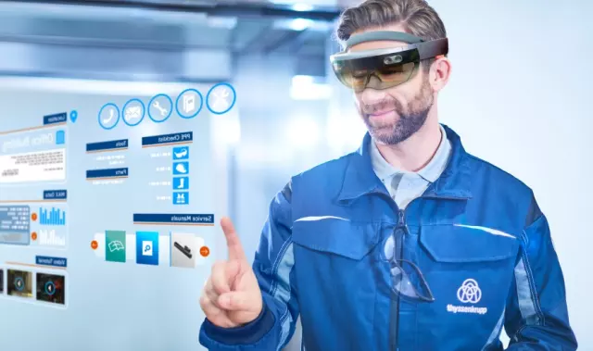
Other uses for VR
https://www.entrepreneur.com/slideshow/281073#1

