Slide 1
Movies

Slide 2
Objectives
Discuss the history of movies in the United States
Define the movie ratings system

Slide 3
A Brief History
Moving pictures came on the scene in the United States in the 1900s as simple silent films.
From the late 1900s to the 1920s, Americans of all social classes flocked to see short, silent films in simple movie houses called nickelodeons, a term that combines the admission price of these films (a nickel) with the Greek term for theater.

Slide 4
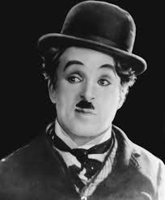
A Brief History
Piano players often accompanied silent films. These short films marked the birth of Hollywood, and actors including Mary Pickford and Charlie Chaplin became the first Hollywood celebrities.

Slide 5
The Birth of a nation
One of the most innovative filmmakers of the day was D.W. Griffith, who transformed the simple format of the silent film and created lengthy movie epics
His best-known work, The Birth of a Nation (1915), was considered a breakthrough in terms of its ability to bring complicated narrative to film and its use of technology. The film had a budget of about $112,000, which would be more than $2 million today.

Slide 6
The birth of a nation
The Birth of a Nation was also extremely racist; in fact, the film is more or less a propaganda piece that celebrates the Ku Klux Klan, an extremist organization responsible for discrimination, violence, and even murder of African Americans and other minority groups.

Slide 7
Talkies
Talkies, or early films that contained image and sound, emerged in the late 1920s. The most famous of these was The Jazz Singer in 1927, which was about a young Jewish man who rebelled against his religious family by singing jazz.

Slide 8
The Golden Age
Talkies made movies even more popular and ushered in the Golden Age of Hollywood, a period that lasted from roughly the late 1920s to the 1950s. This period included the Great Depression and World War II, and Americans sought comfort and escape in the glamorous world of Hollywood films. During this time, powerful studios dominated Hollywood and produced huge numbers of movies in an almost assembly-line fashion.

Slide 9
Let’s go to the movies!
The experience of going to the movies during this time was much different than today. Theaters (many of which were quite fancy and extravagant) usually showed three films: a newsreel, or a short film that showed news footage; a cartoon or short feature; and the main feature. Patrons bought tickets and entered the theater at any time, and stayed until they saw a full cycle, or until they saw enough cycles that they got bored.

Slide 10
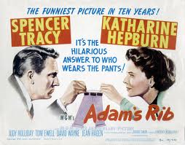
Movies and Culture
Adam's Rib (1949): This film portrayed a husband-and-wife team of lawyers and was greatly ahead of its time in challenging traditional female roles.

Slide 11
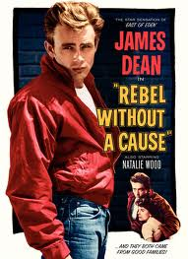
Movies & Culture
Rebel Without a Cause (1955): Portrayed alienated, rebellious young people in an era when young people were strongly encouraged to conform to conservative societal norms.

Slide 12
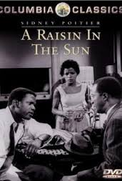
Movies & Culture
A Raisin in the Sun (1961): During the heart of the Civil Rights movement, this films portrayed racism as experienced by an African-American family.

Slide 13
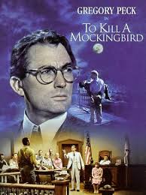
Movies & Culture
To Kill a Mockingbird (1961): In the heart of the Civil Rights movement, this film portrays a white lawyer who defends a wrongly-accused African-American man, and makes a statement about racism in a small town.

Slide 14
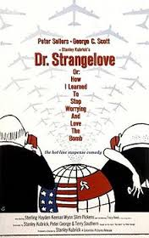
Movies & Culture
Dr. Strangelove, or How I Learned to Stop Worrying and Love the Bomb (1964): A farcical comedy that makes fun of the Cold War and nuclear proliferation.

Slide 15
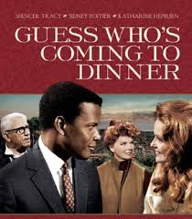
Movies & Culture
Guess Who's Coming to Dinner (1967): Portrayed a relationship between a young white woman and the black man she wants to marry, much to the shock of both sets of parents. Interracial marriage was still taboo at this time.

Slide 16
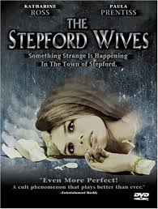
Movies & Culture
Stepford Wives (1975): Portrayed housewives that were scientifically modified by their husbands to be "perfect" wives. In the heart of the women's liberation movement, this film challenged traditional female roles.

Slide 17
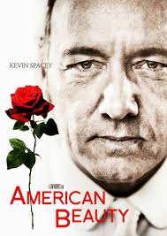
Movies & Culture
American Beauty (1999): Through the story of an unhappy suburban family, this film portrays the American dream of idyllic suburbia as an illusion.

Slide 18
Movie Blockbusters
From the days of The Birth of a Nation, Americans have been transfixed by expensive, epic films that took thousands or millions of dollars to make. However, as Americans increasingly turned away from Hollywood films in favor of television, the Internet, and other media, Hollywood has fought to retain audiences with mega-productions known as blockbusters, or films that take a great deal of money to make and often contain grand, adventurous stories and special effects. Usually blockbusters come out during summer months.

Slide 19
Production Code
Some rules of the Production Code included:
Criminals needed to be punished in some way
No representation of "miscegenation," or relation between people of different races
No depiction of illegal drugs, and only limited representation of alcohol was allowed
No "offensive language"
Authority figures must be treated with respect

Slide 20
Production Code
Religion had to be portrayed in a positive light, and religious officials could not be portrayed as villains
"Scenes of passions" could be used only sparingly and were governed by specific rules; for example, a man and woman could not both be seen in a bed together
Murder and other crimes could not be depicted brutally
The American flag must be treated with respect

Slide 21
MPAA
Rated G: Appropriate for all ages
Rated PG: Parental guidance suggested; some material may not be appropriate for children
Rated PG-13: Parent strongly cautioned that some material may be inappropriate for children under 13
Rated R: Restricted; no admission for anyone under the age of 17 without a parent or guardian present
Rated NC-17: No one under 17 admitted

Slide 22
Self Regulating
Because the MPAA is essentially a self-regulating body of the motion picture industry, it is not law. Therefore, movie theaters and rental stores sometimes don't enforce the ratings system.

Slide 23
Review questions
Attendance at movie theaters declined in the 1950’s due to the:
Depressed economy
Popularity of TV
High price of movie tickets
Enforcement of the production code

Slide 24
Review questions
Attendance at movie theaters declined in the 1950’s due to the:
Depressed economy
Popularity of TV
High price of movie tickets
Enforcement of the production code

