Slide 1
DIGITAL VIDEO REVOLUTION

Slide 2
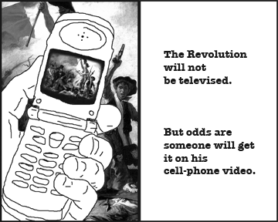
DIGITAL VIDEO REVOLUTION
Digital video is all around us. Gone are the days when you needed a film crew to shoot a video. You can shoot video with something as small as a cell phone. We could also add, "The Revolution may not be televised, but it will be live-blogged.“

Slide 3
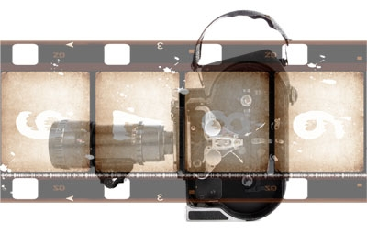
1960: The 16mm Camera
The photo above appears to be a 16mm camera. In the 1960s there were a number of technological innovations that greatly helped reduce the cost of film production; especially smaller, cheaper film cameras. The Super 8 film format, introduced in 1965, was one for the biggest advancements. The lower cost of entry into the field spurred the Cinema Verite movements in the 1960s. This movement placed a higher priority on spontaneous "in-the-moment" filming. Reality was critical. The documentary genre grew as a result.

Slide 4
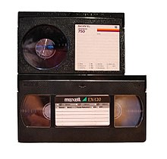
1970s: Betamax vs. VHS
In the 1970s, film based movies were replaced by video cassette recorders for home movie usage. The U-matic system was offered to the public in 1971, however it was not at a price range for most consumers. In the mid 1970s a "video format standard" battle started between the VHS (developed by JVC) standard and the Betamax (developed by Sony) standard.

Slide 5
1980s: Camcorders
Though Sony launched the Betacam in the early 1980s, ultimately the VHS standard won the war due to its ability to record and play back videos on the VCR recorder. In the consumer market, the beta standard slowly fizzled away in the 1980s.
The cost of consumer entry into video production fell again in the 1980s thanks to 8mm and VHS camcorders. Instead of having to shoot on film and incur expensive processing and finish costs, people began to film directly onto VHS tape, which was much cheaper. Sony released the first consumer camcorder in 1983.
Hi-8 (or 8mm cameras) and VHS camcorders were both popular choices. VHS camcorders were often larger than High-8 but had the benefit of shooting directly onto VHS tape that was played in VCRs (Video Cassette Recorders).
VHS and Hi-8 camcorders were popular choices for shooting home videos. Just ask Bob Saget, who ruled the ratings in the late 1980s as host of America's Funniest Videos.

Slide 6
1990s: Digital
In the mid-1990s, a new technology, digital video, came into mainstream use. These cameras used DV (Digital Video) and mini-DV tapes.
The image quality of these cameras was substantially better than the previous generation. The quality was such that news stations would often run segments shot with these cameras.

Slide 7
2000: High Definition Television
In 1979, NHK (Nippon Hoso Kyokai Broadcasting) developed a consumer HDTV (high definition television) system. In the early 1980s, they showed it to producers in the film industry. The quality and detail were as good as images from 35mm film. The industry rolled quickly with this technology, and as early as 1987, PBS (Public Broadcasting System) became the first television network to broadcast in HD.
HDTV has always been the best quality picture to view. For now, it is the cutting-edge technology offered by most networks, including many you is familiar with. They include CBS, NBC, HBO, Madison Square Garden, Warner Bros., PBS, DirecTV, and The Discovery Channel.

Slide 8
VIDEO ACCESSIBILITY TODAY
We are at a point in history when production costs have never been lower, and they keep getting cheaper. Each decade since the '60s cameras have become smaller, cheaper, and better (except for the 16mm cameras we discussed earlier).
This is certainly one of the most exciting times to study and create media because of a convergence of a variety of factors.

Slide 9
Storing the Files
To edit large amounts of footage on a non-linear editing system for film and television production, you would need a powerful computer to store the vast amounts of information recorded on the tape.
But for those of you who want to shoot videos of your family and friends, today's computers come with plenty of memory, storage, and editing software so you can modify your videos at home or school. This easy accessibility of tools means that there are a many more people shooting videos now than at any other time in history. However, quantity does not always equate to quality, as you'll soon see.
So, what do people do with all of these videos? Some people post them on YouTube. Three friends created the video-sharing website in 2005.

Slide 10
2008 and Beyond
Today, as you already know, high-speed Internet is so accessible that you can view videos online. So, by uploading their personal videos to YouTube, people can reach audiences beyond their immediate family and friends.
YouTube is a great place to store your videos too, instead of using storage space on your own computer.
A common trend with YouTube today is that businesses are posting tutorials and teaching aids for their employees to watch. Why not? It's free.

Slide 11
Use and evaluate YouTube.
Students have the option of completing ONE of these TWO assignments:
YouTube research
YouTube is a powerful tool for research. Use the search functions in YouTube to try and find videos on a subject that is interesting to you. It could be anything from stand up comedy to skateboarding, music videos, and much more.
Create a YouTube account and put these videos in your favorites page.
YouTube for entertainment
Content creators are constantly trying to figure out what the next million-click video or series will be. Research some of the most popular videos, series, and channels on YouTube. Do you see any patterns?
Write a paper explaining some common elements (if there are any) in the most popular videos and series. Also, do you have any ideas as to what the next YouTube hit will be? Write down some creative ideas for new videos or series that are targeted at the YouTube market.

