Slide 1
DIGITAL SFX FOR FILM AND VIDEO

Slide 2
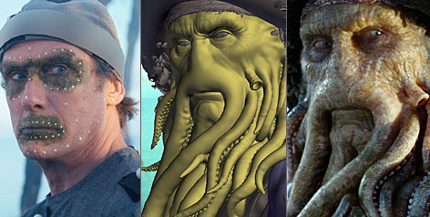
SFX
In the movie industry, SFX is an acronym for Special Effects, which are the magical parts of a film that brings imaginary items to life.
Do you remember Davy Jones from the Pirates of the Caribbean? Would you believe that Davy Jones is completely CG (computer generated)? In this lesson, you will see the specifics of how this amazing character was achieved.

Slide 3
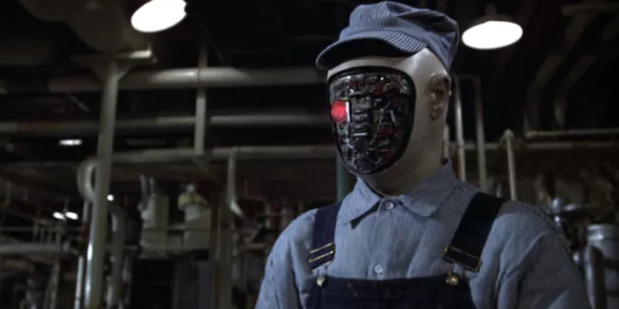
Futureworld
Futureworld (1976) is probably the first feature film that implements the use of 3D animation.
By today’s standards, it looks a little cheesy, but this was an interesting sci-fi in its day. The film is about a dangerous virtual vacation, and it set the stage for later movies along the same theme

Slide 4
THE FIRST USE OF 3D ANIMATION
A few years later, Star Trek: Wrath of Khan (1982) used an even more impressive use of 3D animation. The first fully 3D animated scene in a feature film was created by George Lucas' SFX team at Industrial Light and Magic.
It is amazing to realize that this was cutting-edge technology at the time.

Slide 5
WHY USE SFX?
Special effects have always had a very specific purpose in the motion picture industry. They are used to accomplish shots that would be too expensive, too dangerous or just plain impossible to create by using traditional filming methods.
Digital special effects are really just an outgrowth of a much older tradition. If you go back to the great silent film star, Harold Lloyd in Safety Last (1923), you can see some great silent era special effects.
A bit further along in film history is Dorothy's house flying away in a twister in The Wizard of Oz (1939).

Slide 6
The Kong Contrast
Here is a still frame from King Kong (1933) that employs masterful stop motion work.
Now compare King Kong in the 2005 remake. Please note unbelievable detail in this character. Everything from the lighting to the hair to the amazing facial expression is a masterpiece of digital art.
So you can see that special effects, even to the extent of creating whole characters, is nothing new in the film industry. Audiences crave creative and fresh ideas, so studios are forever trying to outdo what they did last summer.

Slide 7
HOW DO THEY DO THAT?
Refer back to the picture of Davy Jones from Pirates of the Caribbean II. Notice the level of detail.
What are some visual details of Davy Jones?
Write in your notes about your observations of Davy Jones. What are some distinct characteristics that were probably done with SFX?
What helps to make this character feel real is that the details are very specific. Take a closer look at how the SFX team created this character.

Slide 8
HOW DO THEY DO THAT?
First, the crew films the actor with dots on his face and the white balls on his shoulder and body. This is the first step of a process called mocap, which stands for motion capture. The 3D animation program that models and animates the CGcharacter "reads" the dots and white balls and uses them as references for movements on the CG character.
Second, the general facial features, in this case the tentacles, are modeled on top of the actor's image. Lastly, the CG expert adds shades, lighting, and all other details for the final cut.
The actor must be filmed in front of a "green screen" before it is replaced by a background of the filmmaker's choosing.

Slide 9
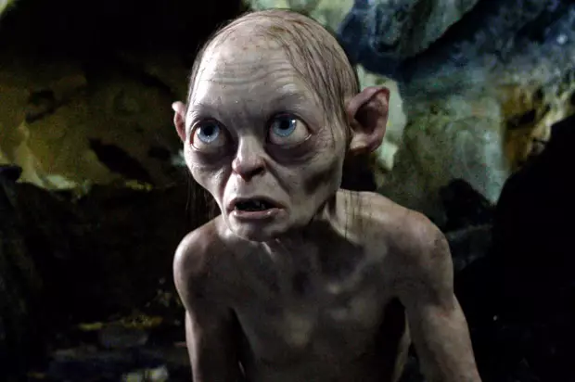
Gollum
Probably the next most memorable and technically polished CG character of recent films is Gollum from the Lord of the Rings series.

Slide 10
The Future of CG
Consider the future of CG in film. Right now, we are able to achieve an extremely high degree of detail and personality in CG film characters. How long do you think it will be before you see photorealistic CG characters in films? And what do you suppose the highly paid Hollywood actors think about being voice actors and flesh puppets to the CG stars that are on the screen? These are interesting and very real questions facing Hollywood in the near future.

Slide 11
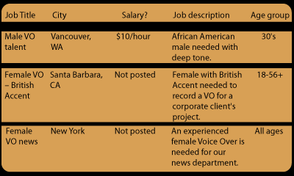
CAREERS IN ANIMATION
Visit Indeed. In the Keyword field, type "3D Animator" Leave the Location field blank. Answer these questions:
How many positions did you find?
Choose three that look interesting to you. What cities were they in? How much were they willing to pay? What is a brief job description? What age does the hiring company want?
Below, is an example of the table citing jobs for Voice Over talent.

