Slide 1
DIGITAL GAMING - A BRIEF HISTORY

Slide 2
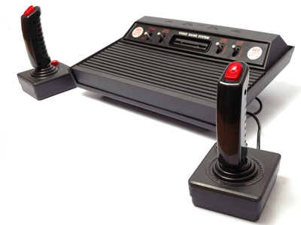
DIGITAL GAMING - A BRIEF HISTORY
Video games have indeed come a long way since the days of the early 1970s. Atari's Pong, a simple 2D version of table tennis launched an industry of gaming. The video game industry has expanded from the domain of computer geeks into an entertainment industry that has recently eclipsed Hollywood in revenue generation.

Slide 3
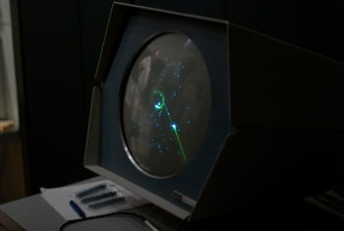
HISTORY OF GAMING
The early game Spacewar was for the PDP-1 computer. The game was installed in the machine by PDP-1 distributors to demo the computer to prospective buyers. The game was converted into a coin-operated machine a few years later but did not fare well due to the steep learning curve.

Slide 4
History of Gaming
The first big coin operated game was the landmark Pong (1971) by newly created Atari. This game sold 19,000 units and started the arcade revolution.
Arcades played an incredibly important social function in (mostly) boys' lives back in the 1970s and 1980s. This is where they went for birthdays or after making some money raking leaves. Arcades were the only place where you could play video games, but people were happy to do this.

Slide 5
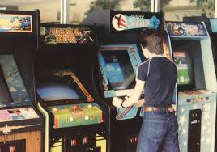
Arcade

Slide 6
Arcade
Some of these old-time video games can now be played for free online. Playing one of these games on a computer with a keyboard is a little like viewing the Mona Lisa in a textbook rather than in person; it's not quite the same experience. However, it's still fun and gives you at least an impression of what these old games were like.
In the late 1970s through the 1980s, while people were going to arcades to play games, they were also playing games on home consoles (like Atari and Colecovision) and PC's (the Commodore 64 was a popular choice). Many of the games that were popular in the arcades were also popular at home.

Slide 7
It is amazing to see just how varied the digital gaming experience can be and how much gaming technology has improved over the years.
Count off how many of these games you recognize:
Pong
Frogger
Microsoft Flight Simulator
Space Quest
Tetris
Doom
Tomb Raider
Pokemon
Wii Sports

Slide 8
Video Games
For a little more historical context, take a look at some of the top selling video games by console. It's interesting to see just how many games have sold one million plus. Since games regularly sell for double or triple what a DVD movie would sell for, this money really adds up.
The King of Kong: Fistful of Quarters is a great documentary about how obsessive gamers can become. In this case, two players vied for the world-record score in Donkey Kong. Their video-game battle is the stuff of legends.

