Slide 1
DIGITAL CINEMATOGRAPHY

Slide 2
DIGITAL CINEMATOGRAPHY
Many movies are now shot on HD cameras rather than traditional 35mm film cameras. Advances in cinematography are revolutionizing the filming industry.
In this lesson, we will explore the explosive growth of digital and HD formats for feature films. We will also examine traditional pre-production techniques.

Slide 3
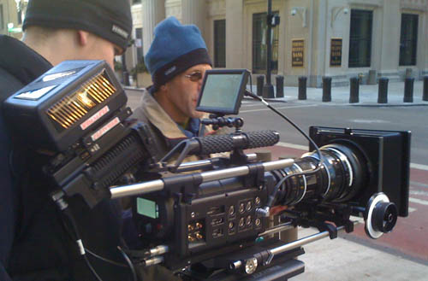
ROLE OF THE CINEMATOGRAPHER
Here we see a RED digital camera on location. Alongside the camera we see two crew members. One of the crew members pictured is likely the cinematographer. You will sometimes hear the cinematographer referred to as the director of photography or DP.
This person is in charge of shooting the production as well as directing the grips and gaffers to create the proper lighting. Sometimes they will operate the camera, while other times that role belongs to another crew member called the camera operator, whose function is to shoot at the direction of the cinematographer.

Slide 4
ROLE OF THE CINEMATOGRAPHER
Higher end video productions will have cinematographers just like film productions. On lower budget productions, the director may pull double duty as both the director and cinematographer.
These same elements are important in composing good moving images as well, but we can add a few more details to the list. Cinematographers have to understand also that they are telling a story (they are telling it visually rather than with words). So when a particular shot is chosen, it must serve the narrative of the story. It also has to be edited into the other shots of the scene. So the job of the cinematographer is arguably more complex than that of the photographer.

Slide 5
DIGITAL VIDEO VS. FILM
There is a debate that has been raging for nearly a decade now in the movie industry. That debate revolves around whether or not digital video will someday surpass 35mm film as the dominant format for feature films.
There are still many filmmakers who resist the change to digital technology for capturing moving images. Many of the proponents for remaining with 35mm believe that film still has a "warmer" look than digital video
Some film directors such as Christopher Nolan, Paul Thomas Anderson[and Quentin Tarantino have publicly criticized digital cinema, and advocated the use of film and film prints. Tarantino has suggested he may retire because he will no longer be able to have his films projected in 35mm in most American cinemas. Tarantino considers digital cinema to be simply "television in public."

Slide 6
In Class Assignment
Read this article: https://www.independent.co.uk/arts-entertainment/films/features/dunkirk-film-digital-christopher-nolan-quentin-tarantino-paul-thomas-anderson-lawrence-of-arabia-a7918586.html
Write minimum 500 words in favor either Digital or non-Digital Film Formats.

