Slide 1
Advertising & Persuasion

Slide 2
Bandwagon Approach
An advertising technique dependent on the desire of people to do what others are doing. In these types of ads, the product is typically being used by a large number of people. The goal is have other people follow.

Slide 3
Bandwagon Example:
https://www.youtube.com/watch?v=fAT5UkTc-SQ

Slide 4
Celebrity Testimonial
An advertising technique that involves showing a famous and admired person using the product and speaking highly of it.
https://www.youtube.com/watch?v=AKKM8sP24BE

Slide 5
Emotional Elements
An advertising technique that appeals to an emotional aspect of the target population
https://www.youtube.com/watch?v=WIRUhudMwEY

Slide 6
Name Calling
An advertising technique in which an advertiser makes a brand look favorable by speaking badly about another product.
https://www.youtube.com/watch?v=ZwQpPqPKbAw&index=4&list=PL2B73A382291A18C5

Slide 7
Omission
An advertising technique that involves leaving out facts about a product showing attractive images that make a product more appealing.
https://www.youtube.com/watch?v=yd504ZWGhmg

Slide 8
Repetition/Salience
An advertising technique in which the advertiser attempts to get a consumer to remember a product by frequently repeating a product’s name, frequently showing images of the product and its logo, and by frequently running an ad.
https://www.youtube.com/watch?v=f_SwD7RveNE

Slide 9
Scaling
An advertising technique in which a product is visually made to look “larger than life” and therefore more appealing.
https://www.youtube.com/watch?v=m9DZ-8Uv3Z0

Slide 10
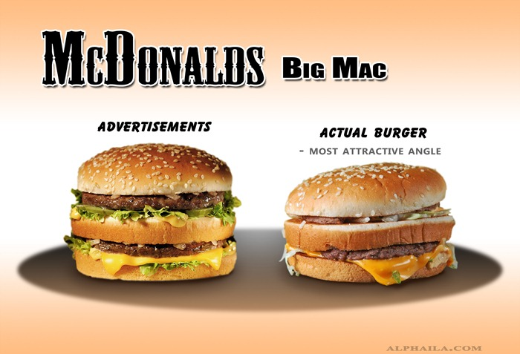
Selective Editing
An advertising technique in which the advertiser who is filming the advertisement includes only the film segments that make the product look most appealing.

Slide 11
Use of Humor
An advertising technique in which an advertiser attempts to grab the audience’s attention by being funny.
https://www.youtube.com/watch?v=x8uA8GS_wKY

