Slide 1
Television as Business: Minimizing the Risk
2-4-14

Slide 2
Objective
Discuss the strategies television executives use to minimize the risk of losing money.

Slide 3
Minimizing the Risk
In the TV business, this means decreasing the chances that television shows will lose money by not earning enough ratings.

Slide 4
Reliance on Genres
Genre refers to the types of TV shows, or categories of programming that are defined by a certain type of elements.
Situation Comedy
Drama
Reality TV Show
Sports Broadcast
Talk Show
Game Show
Cooking Show
Soap Opera

Slide 5
Characteristics of Genres
Each type of genres has certain common characteristics. The audience expects that each of these genres will look and sound a certain way and will contain certain kinds of characters and plots.
Characters – genres usually have certain things in common.
Plot – a plot is a storyline. Each genre usually sticks to story lines that have certain things in common.
Aesthetics – elements that have to with how a TV show looks and sounds (lighting, set design, music, laugh tracks)

Slide 6
Copies
In TV, a copy refers to a TV show that is very similar to one that is already been a success.

Slide 7
Spin-Offs
TV shows that feature a character that has appeared on an already successful TV show.

Slide 8
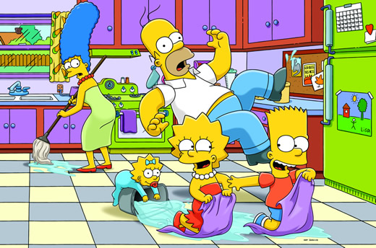
Syndication
One of the most profitable ways that TV makes money is through syndication. This refers to a programs that isn’t affiliated with a particular network, but rather is “rented out” by networks.
Many shows go into syndication after they have gone off the air, or they have been on air for a long time.

Slide 9
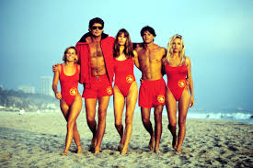
International Market
TV shows can also make money if they hit it big with international market. This is away for TV shows to earn money without having to produce a new, expensive show.

Slide 10
Use of Cheaper Formats
Reality TV Shows.
They are cheaper than normal TV shows

Slide 11
Homework
You will write ideas for 3 new TV shows.
The first show will be a copy.
The second show will be a spinoff
The third will be original based on a genre categories.
Needs to be in complete sentences and paragraphs.
Due Wednesday

