Slide 1
3D ANIMATION - MORE THAN ENTERTAINMENT

Slide 2
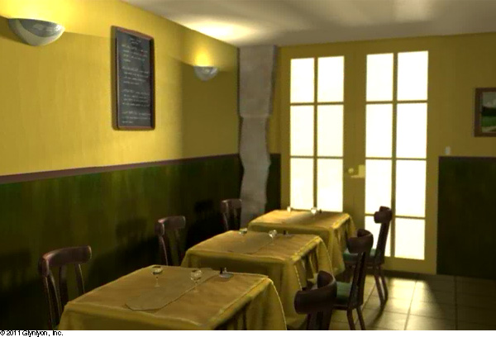
Reality or Digital?
You have seen images from original photographs and from digitally enhanced ones. You have seen videos of 3D characters with such painstaking detail that the hair looks real. Can you be fooled (or not) with this image? Is it real or is it digitally created?

Slide 3
3D ANIMATIONS IN THE MEDICAL FIELD
What do you think this image is depicting?
Your guess is as good as anyone else's. It may be illustrating how a medicine interacts with the body at a molecular level.
Definitely, this image is a still frame from the medical field. The medical community has wide and varied uses for animations.

Slide 4
3D Animation in Medical Field
Watch this video: 3D Animation in Medical Field
This clip was made to educate physicians about a new medical product that controls the bleeding from a wound.
Respond
Do you think you could apply the WoundStat to yourself?
Did you wonder if it might hurt or sting?
Can you imagine showing real injuries instead of a 3D animation?
Do you think the 3D animation is effective?

Slide 5
3D Animation in Medical Field
You have witnessed a few examples of how the medical field uses animations. Animations can:
Train surgeons and doctors on procedures
Show doctors and patients how medicines interact with the human body
Depict human phenomena so that you can understand processes better
Explain complex procedures without harming an animal or human
Illustrate how different organs function

Slide 6
3D RENDITIONS IN THE ARCHITECTURAL FIELD
Architectural projects can cost millions of dollars. Therefore, clients like to see renditions of a finished project before they spend their money with an architectural firm. 3D animations and models are often used for this kind of work. Some are quite detailed, even including cars, trees, and people. Creating the right lighting in a 3D environment, particularly interiors, is critical.

Slide 7
3D RENDITIONS IN THE ARCHITECTURAL FIELD
How does an architecture student advance in each stage of his education? First he starts by drawing his ideas on paper. Then he builds his plans with modeling wood and clay. Use your notes to answer these thought-provoking questions.
At first, the student's work is done on paper. Why do you think the lesson assignments are done on paper first?
What skills are required to be successful as an architect?
Is architecture something you might be interested in studying? Why or why not?
What do you think an architect can make in one hour? Of course, it depends on the project. But do some research and find a web site that contains salary information for this career.

Slide 8
CREATING YOUR OWN ANIMATION
Now, let's switch gears from concept to practice. You will get a great introduction to creating perhaps your first animation. You may find that you have talent or have an interest in this area that you had never considered. If so, this software will be the beginning of your exciting journey into the world of animation production.
Shapeshifter
Shapeshifter deals with only a few simple shapes that you can manipulate and get some interesting results.

Slide 9
Using Shapeshifter
Now it’s time to create some simple animations in Shapeshifter. Familiarize yourself with the software. Experiment with moving simple shapes around the workspace.
In this lesson, we want you to get comfortable working with this program. Learn what you can and can't do with it.
Take a look at some of the other work on the site, including the good, the bad, and the ugly.
Get some ideas for your final animation piece (which is next lesson’s project).
Once you get comfortable with the program, figure out what you would like to do for next week’s project. Write out a short concept in three to four paragraphs.

