Slide 1
How People use the media
6th Grade

Slide 2
Media as equipment for living
Equipment for living – helps make sense of their own lives.
Have you ever done this?

Slide 3
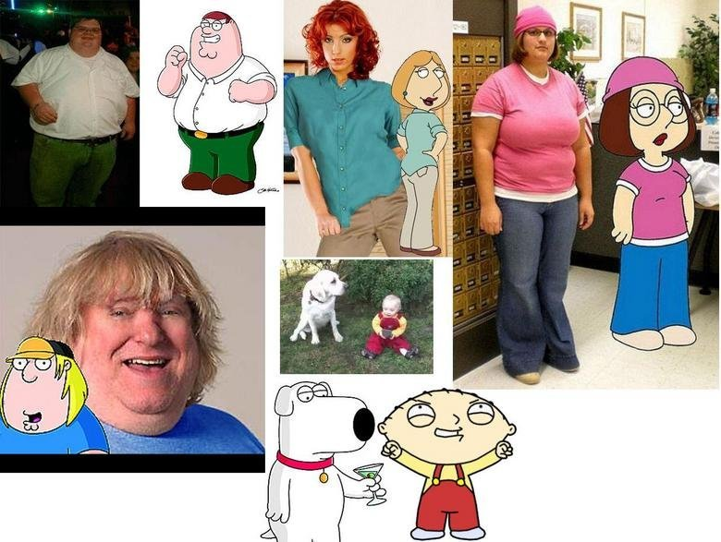
Relating to shows and Characters
Finding characters in pop culture that you can relate to (going through same problems)

Slide 4
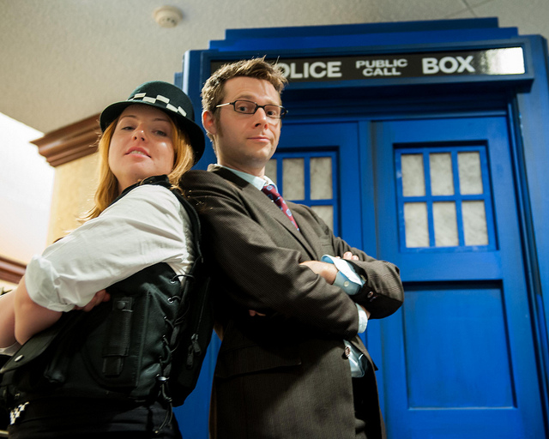
Media as an Outlet
Playing video games to relax
Listing personally relevant lyrics on Facebook
Using catchphrases of pop culture characters
Having social media events in which people gather to watch a TV show or movie
Children imitating characters from TV shows and movies
Science fiction or comic book conventions, where people gather to discuss pop culture and sometimes dress as their favorite characters .

Slide 5
Internet as interpersonal communication
People use Internet to communicate with one another.
Social Networking Website
YouTube
Internet Discussion Boards

Slide 6
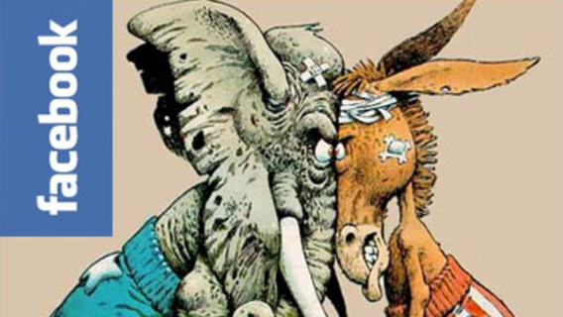
Political Involvement & The Media
People use Internet as way to get involved in politics.
Research political information
Making political statements

Slide 7
Review Questions
1. Wikipedia A. Social Network Service
2. Google B. Social Network Service (Originally for college students)
3. YouTube C. Search Engine
4. Facebook D. Video Hosting Service
5. MySpace E. Weblog Host
6. Blogger.com F. Online Encyclopedia
7. Classmates.com G. Social network for former classmates

