Slide 1
That’s Entertainment

Slide 2
Today’s Objectives
Discuss the significant portion of time people spend using media
Identify the corporations that control the media
Explain how the media powerfully impacts people’s behavior, attitude and socialization

Slide 3
Vocabulary
Media – this term refers to kinds of technology that people use to communicate information. Media is the plural form of medium.
Media Literacy – This is a worldwide educational movement that aims to teach people to understand how the media effect both individuals and society as a whole
Popular Culture – Media that people use in their everyday lives primarily for entertainment and pleasure, as opposed to more serious uses. Although popular culture can have artistic value, we generally thing of pop culture as material that’s part of “everyday life” (like reality TV, hip-hop, video games, or People magazine) as opposed to sophisticated “high” culture (like opera or sculpture).

Slide 4
People
Young people spend a significant portion of their lives using the media.
Research shows that the average American watches between twenty-four to twenty-eight hours of TV per week. Over a lifetime, this comes to about 7 to 9 years of our lives. This comes to about 3 years worth of TV commercials

Slide 5
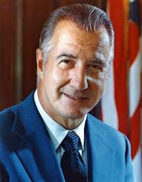
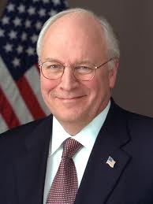
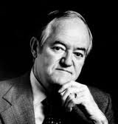
Media
Do you know these people?

Slide 6
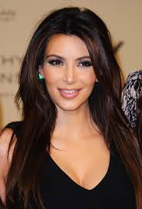
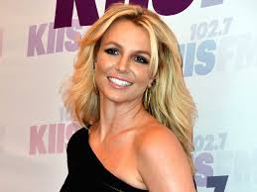
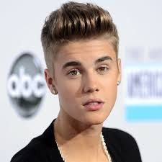
Media
Do you know these people?

Slide 7
Who owns’ the media
GE – Comcast, NBC, Universal Pictures
News-Corp – Fox, Wall Street Journal, New York Post
Disney – ABC, ESPN, Pixar, Miramax, Marvel Studios
Viacom – MTV, Nick Jr. BET, CMT, Paramount Pictures
Time Warner – CNN, HBO, Time, Warner Bros.
CBS – Showtime, Smithsonian Channel, NFL.com, Jeopardy, 60 Minutes

Slide 8
Behavior, attitudes, & socialization
Behavior – an action, or something that someone does. Although we have free will, many things influence our behavior – our families, our peers, our religious institutions, our schools, and of course the media.
Attitudes – ideas that we walk around with in our head about how the world works. Attitudes lead to behaviors.
Socialization – the process through which a person learns about the norms of one’s culture, including how one is supposed to behave in various situations, which values one is supposed to consider to be important, and the roles that men and women are supposed to play. This is the process through which we learn how to “fit in”

Slide 9
Review questions
How much television does the average American child watch per week?
15 Hours
25 hours
50 hours
100 hours

Slide 10
Review questions
How much television does the average American child watch per week?
15 Hours
25 hours
50 hours
100 hours

Slide 11
Review Questions
In the United States, the government controls and owns a very large percentage of the media.
True
False

Slide 12
Review Questions
In the United States, the government controls and owns a very large percentage of the media.
True
False

Slide 13
Review Questions
Which of the following is not one of the six biggest media corporations in the United States?
Disney
Time Warner
Microsoft
Viacom

Slide 14
Review Questions
Which of the following is not one of the five biggest media corporations in the United States?
Disney
Time Warner
Microsoft
Viacom

Slide 15
Review Questions
The link between violence in the media and school shootings has been proven to be direct.
True
False

Slide 16
Review Questions
The link between violence in the media and school shootings has been proven to be direct.
True
False

Slide 17
Review questions
Media _______ refers to a worldwide educational movement that aims to teach people to understand how the media affect both individuals and society as a whole.
literacy
consolidation
socialization
effects

Slide 18
Review questions
Media _______ refers to a worldwide educational movement that aims to teach people to understand how the media affect both individuals and society as a whole.
literacy
consolidation
socialization
effects

