Slide 1
2D Animation
Digital Arts

Slide 2
THE BEGINNINGS OF ANIMATION
Eadweard Muybridge took this famous set of photos in 1877. The photos were taken in California to settle a dispute between two men who could not agree on whether a horse was airborne while running. In other words, are all four feet off the ground at the same time? Muybridge set up several cameras equidistant from each other and took photos sequentially. Many people consider Muybridge the father of modern motion pictures because of this work.
Out of this work, both film and animation were born.

Slide 3
Early Animation
Neither film nor animation would be successful if not for the persistence of vision. This is when an image sticks within your brain even after it has been removed from your sight. Persistence of vision is believed to be the cause of the illusion of movement when you view a flipbook or a series of film images.

Slide 4
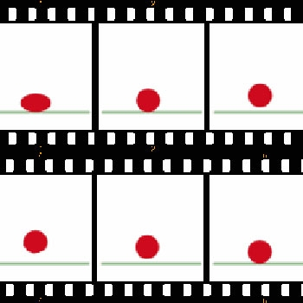
Early Animation
Early filmmakers discovered that the human eye begins to see smooth motion when 12 still frames are displayed per second. Many animation programs will allow you to edit the frames per second (fps) adjusting the smoothness of the animation.

Slide 5
2D Software
Before the use of computers, the 2D animation process was a very labor-intensive activity. Even with computers, it still requires hard work to get great results, but at least you can automate some of the processes.
Adobe Flash is the most popular 2D animation application today. It allows for seamless integration of web pages, video, animation, and audio. There are a considerable number of high profile animations that have been created using Flash.

Slide 6
Assignment
FLIP BOOK - a small book containing a series of images of the same thing in different positions that create the illusion of movement when the pages are turned quickly
ASSIGNMENT:
The most basic form of animation is a flip book, which will be the first animated project that is produced in class. Using the specification listed below, create a flip book contain a minimum of 16 pages. You may choose more pages, however, keep in mind that the project will only encompass today and tomorrow. The flip book can be about anything that you want, just make sure that the flip book is school appropriate..
SPECIFICATIONS:
• Using 3” X 5” or 4” X 6” index cards
• Name and number in the sequences should be put on the back of each card
• Try not to draw on the entire card, cause something will get lost during the flipping
• Backgrounds are optional, unless they are part of the animation
• Colors are optional
• Do not staple the cards

